Slide 1
Introduction to Matlab
Signals & Communication Systems Lab

Slide 2
What is Matlab?
Matlab is basically a high level language which has many specialized toolboxes for making things easier for us
Matlab
High Level
Languages such as
C, Pascal etc.
Assembly

Slide 3
What are we interested in?
Matlab is too broad for our purposes in this course.
The features we are going to require is
Matlab
Series of Matlab commands
m-files
Command
Line
mat-files
functions
Command execution like DOS command window
Data storage/ loading
Input
Output
capability

Slide 4
Physical Problem
Mathematical Models
Solving Mathematical Equations

Slide 5
Introduction
MATLAB (short for MATrix LABoratory) is a powerful computing environment that handles anything from simple arithmetic to advanced data analysis.
At its core is the matrix as its basic data type.
Combined with extensive maths and graphics functions, complicated calculations can be carried out by specifying only a few simple instructions.
MATLAB can be used to do anything your scientific calculator can do, and more.
The installations in the computer labs include tool boxes that include functions for electrical engineering related tasks, such as signal processing and system analysis.
Notes:
5

Slide 6
Introduction. . . .
The installations in the computer labs include tool boxes that include functions for electrical engineering related tasks, such as signal processing and system analysis.
You can plot your data in a multitude of visualizations as well.
Computations can be carried out in one of three ways:
1. Directly from the command line,
2. by writing a script that carries out predefined instructions, or
3. by writing your own functions.
Notes:
6

Slide 7
Introduction . . .
Writing your own functions is much like programming in other languages, except that you have the full resources of MATLAB’s functions at your disposal, making for very compact code.
The MATLAB-6 and above environment has several windows at your disposal.
Command Window: The main window is the command window, where you will type all your commands, for small programs.
Notes:
7

Slide 8
Desktop Tools
Command Window
  type commands
Workspace
  view program variables
  clear to clear
  double click on a variable to see it in the Array Editor
  Command History
  view past commands
  save a whole session using diary
Launch Pad
  access tools, demos and documentation

Slide 9
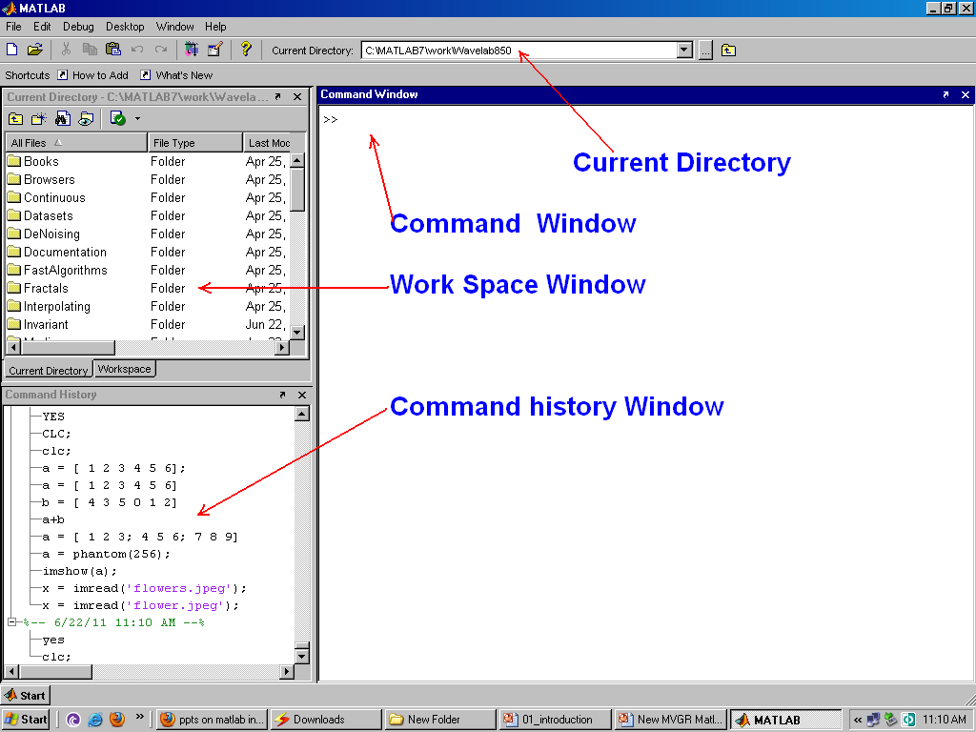

Slide 10
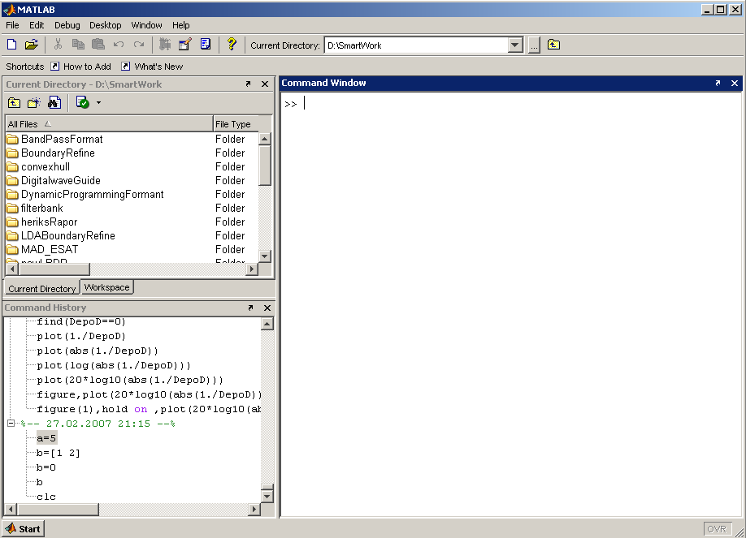
Matlab Screen
Command Window
  type commands
Current Directory
  View folders and m-files
Workspace
  View program variables
  Double click on a variable
  to see it in the Array Editor
Command History
  view past commands
  save a whole session
  using diary

Slide 11
Command History
* A command history, which contains a list of all the commands that you have typed in the command window.
* This makes it easy to cut and paste earlier lengthy commands, saving you the effort of typing it over again.
* This window can also display the contents of the current directory.
Notes:
11

Slide 12
Workspace & Launch pad
The third window displays one of two things:
* The launch pad from which you can browse the installed toolboxes and launch various tools as well as view demonstrations, and
* The workspace, which lists all the variables that are currently in memory as well as their sizes.
Notes:
12

Slide 13
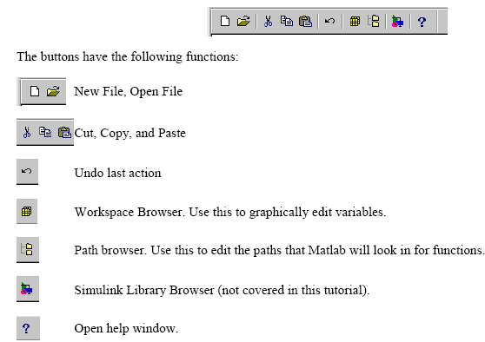
The Toolbar

Slide 14
Vectors and Matices and their Manipulation
Notes:
14

Slide 15
Definition of Vectors & Matrices
MATLAB is based on matrix and vector algebra; even scalars are treated as 1x1 matrices. Therefore, vector and matrix operations are as simple as common calculator operations.
Vectors can be defined in two ways.
* The first method is used for arbitrary elements:
v = [1 3 5 7]; creates a 1x4 vector with elements 1, 3, 5 and 7.
* Note that commas could have been used in place of spaces to separate the elements. that is v=[1,3,5,7];
Additional elements can be added to the vector: v(5) = 8;
yields the vector v = [1 3 5 7 8].
Notes:
15

Slide 16
Previously defined vectors can be used to define a new vector. For example, with ‘v’ defined above
a = [9 10];
b = [v a];
creates the vector b = [1 3 5 7 8 9 10].
Notes:
16

Slide 17
Second Method
The second method is used for creating vectors with equally spaced elements:
t = 0: 0.1:10;
creates a 1x101 vector with the elements 0, .1, .2, .3,...,10. Note that the middle number defines the increment.
If only two numbers are given, then the increment is set to a default of 1:
For ex. k = 0:10; creates a 1x11 vector with the elements 0, 1, 2, ..., 10.
Notes:
17

Slide 18


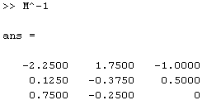

* Matrices are defined by entering the elements row by row:
M = [1 2 4; 3 6 8; 2 6 5];
creates the matrix
* Transpose of M is denoted by
M’, and displays as
*The inverse of M is M⁻¹ denoted in Matlab as M^-1and displays as
* M(2,3) displays the element of second row and third column
Notes:
18

Slide 19

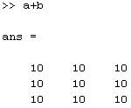
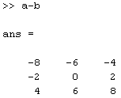
Arithmetic Operations
When applying addition, subtraction, multiplication and division between a scalar (that is a single number) and a vector we use +, -, *, and / respectively.
Let
Then a + b gives
a - b gives
Notes:
19

Slide 20
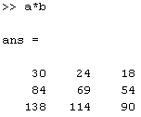
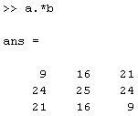
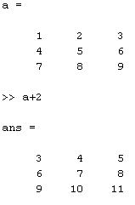
aXb in Matlab a*b displays
In Matlab a.*b gives element wise multiplication
a+2 gives
Notes:
20

Slide 21
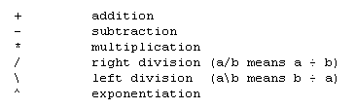
Algebraic manipulations
Scalar Calculations. The common arithmetic operators used in spreadsheets and program-ming languages such as BASIC are used in ‘Matlab'.
In addition a distinction is made between right and left division. The arithmetic operators are
Notes:
21

Slide 22
Operators (relational, logical)
= = equal
~= not equal
< less than
<= less than or equal
> greater than
>= greater than or equal
& AND
| OR
~ NOT
pi 3.14159265…
j imaginary unit,
i same as j

Slide 23
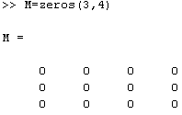
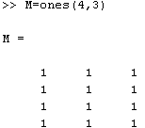
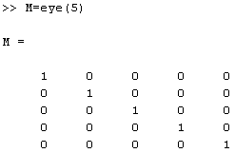
Special Matrices
null matrix:
M = [ ];
nxm matrix of zeros:
M = zeros(n,m);
nxm matrix of ones:
M = ones(n,m);
nxn identity matrix:
M = eye(n);
Notes:
23

Slide 24
Help, Document and Demos
Matlab provides excellent tutorials that are accessible by typing
>>demo
The Basic matrix operations tutorial under the Matrices tutorial, the Image Processing and Signal Processing tutorial under Toolboxes are highly recommended.
To get information on a particular function of Matlab, we type
>>help function_name
Example:
>> help fft
>> help mean
Notes:
24

Slide 25
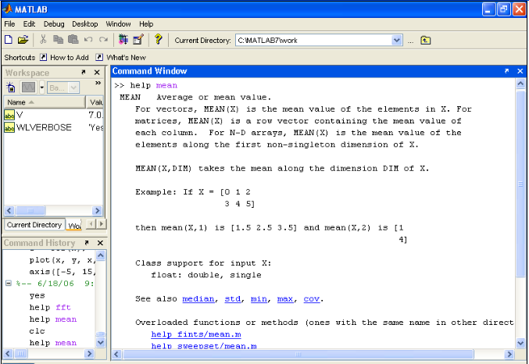
Getting Help
The Help pull-down menu gives you access to all the help pages included with MATLAB.
Notes:
25

Slide 26
Comments in Matlab must be proceeded by %
% This is a comment in Matlab.
To define a function in Matlab, we first create a function with the name of the function.
*We then define the function in the file.
*For example, the Matlab documentation recommends stat.m written as:
function [mean,stdev] = stat(x)
% This comment is printed out with help stat
n = length(x); % assumes that x is a vector.
mean = sum(x) / n; % sum adds up all elements.
stdev = sqrt(sum((x - mean).^2)/n);
Notes:
26

Slide 27
Viewing Matlab Matrices as one Dimensional Arrays
Convert multi-dimensional to a one-dimensional array by simply using array_name(:)
» a(:)
ans =
1
4
7
2
5
8
3
6
9
Note that the elements in the one-dimensional array are arranged column by column, not row by row. This is the same convention that is used for two dimensional arrays in Fortran, and this will also be the convention that we will adopt for representing two dimensional arrays in C++.
Notes:
27

Slide 28
Displaying and Printing in Matlab
To plot an array or display an image, select the figure using:
» figure(1); % select the figure to display.
» clf % clear the figure from any
% previous commands.
and use plot for displaying a one-dimen-sional array:
» plot ([3 4 5 3 2 2]); % plots broken-line graph.
or use imagesc for displaying a two dimensional array (image):
Notes:
28

Slide 29

One-dimensional random access iterator (using an index array)
[1 5 9 2 6 10 3 7 11 4 8 12]
» I=[1 5 8 10]; % indices apply to one-dimensional array a(:)
» a(I)
ans =
1 6 7 4
  two dimensional iterators
» a(1:2,1:3)
ans = 1 2 3
5 6 7 .
Notes:
29

Slide 30
Working with Memory in Matlab
To keep track of how memory is allocated, we use whos
» b=[34 54 56];
» a=[2 3 56];
» whos
Name Size Bytes Class
a 1x3 24 double array
b 1x3 24 double array
Grand total is 6 elements using 48 bytes
We may then get rid of unwanted variables using clear
» clear a; % removes the variable a from the memory.
We can use clear all to remove all variables from memory (and all functions and mex links) and close all to close all the figures and hence save a lot of memory.
Notes:
30

Slide 31
Since Matlab supports dynamic memory allocation, it is possible to make inefficient use of the memory due to memory fragmentation problems. In this case, the pack command can be used to defragment the memory and help reclaim some of the memory.
To use memory efficiently, it is best to avoid changing the number of elements in an array during execution. It is best to
preallocate arrays before using them. To this end we can use zeros and ones:
» a=zeros(3,4); % a two-dimensional 3x4 zero matrix.
» b=ones(1,5); % an array of 5 elements of value 1.
Notes:
31

Slide 32
Evaluating one-dimensional functions in Matlab
To evaluate one-dimensional functions in Matlab we need to specify the points at which we would like our function to be evaluated at.
We can use either the built-in colon notation to specify the points » t=-1:0.5:1
t = -1.0000 -0.5000 0 0.5000 1.0000
or use linspace( )
» t=linspace(-2,4,5) % generates 5 points
% between -2 and 4
t = -2.0000 -0.5000 1.0000 2.5000 4.0000
or use logspace( )
Notes:
32

Slide 33
Evaluating one-dimensional functions in Matlab (contd)
In general, all numbers in Matlab are double. Complex numbers are represented by multiplying the imaginary part by 1i. For example, 1+3j can be represented by 1+1i*3 or 1+3i.
All the well-known mathematical functions are defined in Matlab, and but they apply to to each element in the vector directly.
For example, cos([2 3 4]) is equivalent to [cos(2) cos(3) cos(4)].
Notes:
33

Slide 34
Evaluating two-dimensional functions in Matlab
To evaluate two-dimensional functions in Matlab we use the built-in function meshgrid ( ) with the ranges for x and y; eg:
» [x,y]=meshgrid(0.1:0.1:0.3, 0.2:0.1:0.4)
yields the matrices x and y given by:
x =
0.1 0.2 0.3
0.1 0.2 0.3
0.1 0.2 0.3
Notes:
34

Slide 35
y =
0.2 0.2 0.2
0.3 0.3 0.3
0.4 0.4 0.4
We may then apply any binary operation to x and y provided that we preceed each operation with a period.
For example x.*y represents the matrix where each element of x multiplies each element of y.
Similarly, exp(x.^2+y.^2) represents the matrix resulting from applying exp( ) to the sum of the squares of each of the elements of x and y.
Notes:
35

Slide 36
Flow Control
if
for
while
break
….

Slide 37
Control Structures
Some Dummy Examples
if ((a>3) & (b==5))
Some Matlab Commands;
end
if (a<3)
Some Matlab Commands;
elseif (b~=5)
Some Matlab Commands;
end
if (a<3)
Some Matlab Commands;
else
Some Matlab Commands;
end
If Statement Syntax
if (Condition_1)
Matlab Commands
elseif (Condition_2)
Matlab Commands
elseif (Condition_3)
Matlab Commands
else
Matlab Commands
end

Slide 38
Control Structures
Some Dummy Examples
for i=1:100
Some Matlab Commands;
end
for j=1:3:200
Some Matlab Commands;
end
for m=13:-0.2:-21
Some Matlab Commands;
end
for k=[0.1 0.3 -13 12 7 -9.3]
Some Matlab Commands;
end
For loop syntax
for i=Index_Array
Matlab Commands
end

Slide 39
Control Structures
While Loop Syntax
while (condition)
Matlab Commands
end
Dummy Example
while ((a>3) & (b==5))
Some Matlab Commands;
end

Slide 40
Generation and plotting of basic signals
Notes:
40

Slide 41
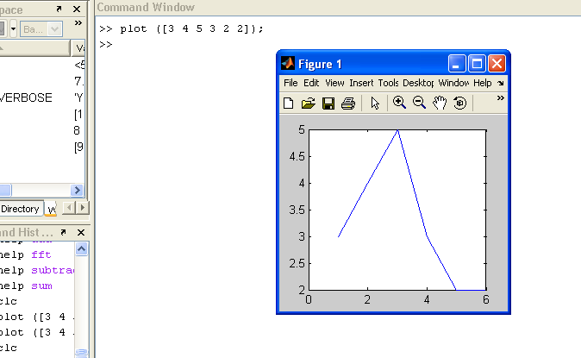
Simple plot
Notes:
41

Slide 42
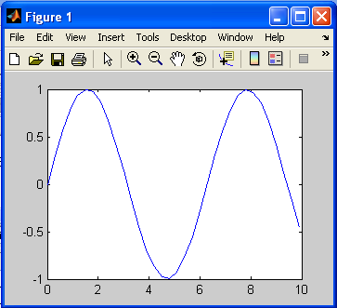
To make a graph of y = sin(t) on the interval t = 0 to t = 10 we do the following:
>> t = 0:0.3:10;
>> y = sin(t);
>> plot(t,y) ;
Notes:
42

Slide 43
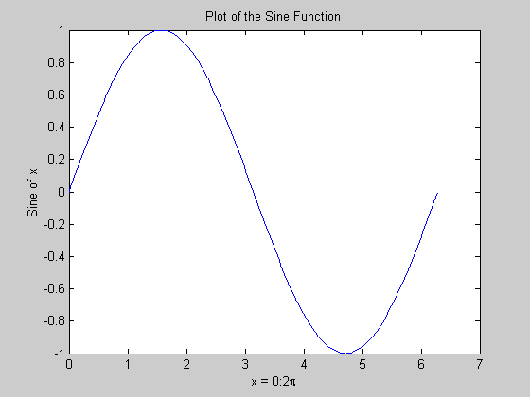
Matlab Graphics
x = 0:pi/100:2*pi;
y = sin(x);
plot(x,y)
xlabel('x = 0:2\pi')
ylabel('Sine of x')
title('Plot of the Sine Function')

Slide 44
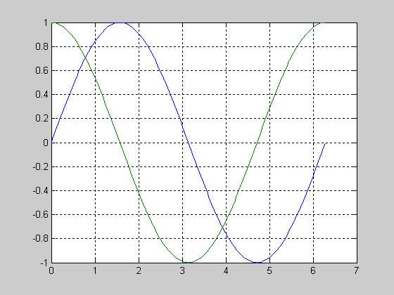
Multiple Graphs
t = 0:pi/100:2*pi;
y1=sin(t);
y2=sin(t+pi/2);
plot(t,y1,t,y2)
grid on

Slide 45
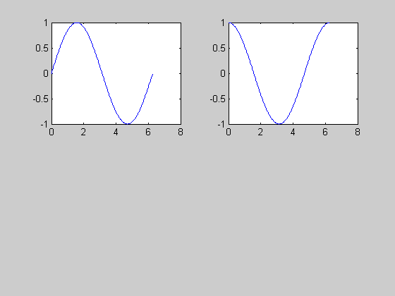
Multiple Plots
t = 0:pi/100:2*pi;
y1=sin(t);
y2=sin(t+pi/2);
subplot(2,2,1)
plot(t,y1)
subplot(2,2,2)
plot(t,y2)

Slide 46
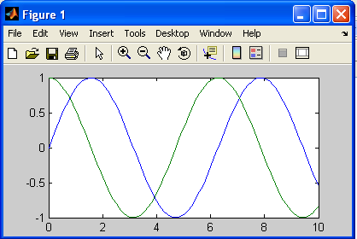
Second, I can plot several different sets of data together:
>> x = 0 : 0.1 : 10;
>> y = sin(x);
>> z = cos(x);
>> plot(x, y, x, z);
Notes:
46

Slide 47
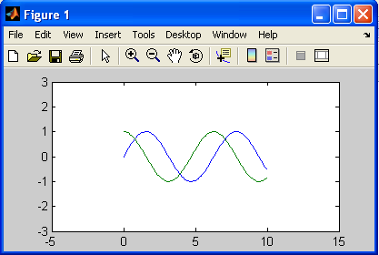
Another useful command is axis, which lets you control the size of the axes. If I've already created the plot with both sine and cosine functions, I can resize it by typing
>> axis([-5, 15, -3, 3]);
which changes the plotting window so it looks like this:
Notes:
47

Slide 48
f (x)=sin (x)³ +cos(3x)
over one period
syms x;
ezplot(sin(x)^3+ cos(3*x), [-pi pi], 1);
grid on;
Notes:
48

Slide 49
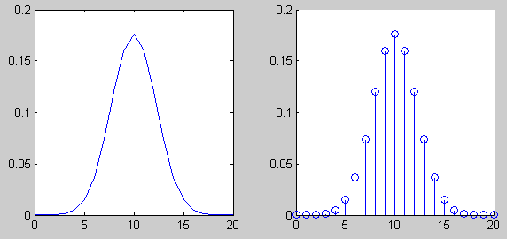
Continuous and Discrete time plots
k=0:20;
y=binopdf(k,20,0.5);
plot(k,y)
k=0:20;
y=binopdf(k,20,0.5);
stem(k,y)

Slide 50
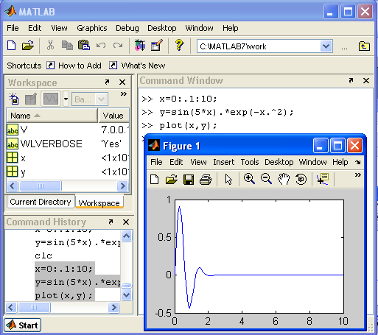
Plotting
Notes:
50

Slide 51
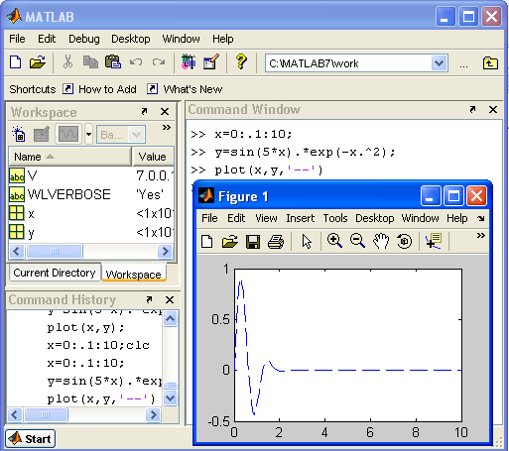
Notes:
51

Slide 52
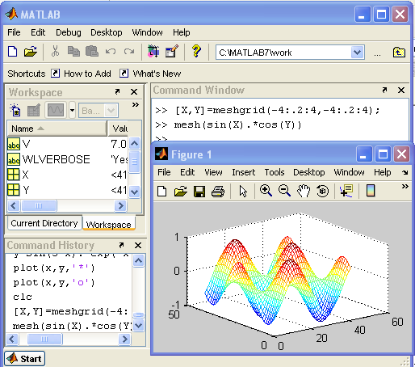
Notes:
52

Slide 53
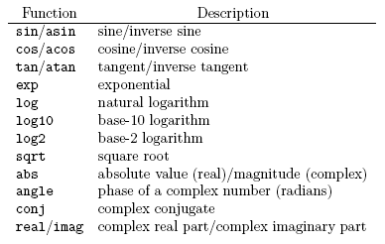
Commonly Used Mathematical Functions
Notes:
53

Slide 54
Using Matlab Editors
Very small programs can be typed and executed in command window.
Large programs on other hand can be used the Matlab editor.
The complete program can be typed in the Matlab editor and saved as ‘file_name.m’, and can be retrieved when-ever necessary.
You can execute either directly from editor window or type the file name in the command window and press the enter button.
Notes:
54

Slide 55
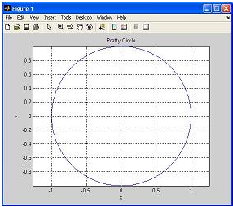
Creating, Saving, and Executing a Script File
% CIRCLE - A script file to draw a pretty circle
function [x, y] = prettycirclefn(r)
% CIRCLE - A script file to draw a pretty circle
% Input: r = specified radius
% Output: [x, y] = the x and y coordinates
angle = linspace(0, 2*pi, 360);
x = r * cos(angle);
y = r * sin(angle);
plot(x,y)
axis('equal')
ylabel('y')
xlabel('x')
title(['Radius r =',num2str(r)])
grid on

Slide 56
Graph Functions (summary)
plot linear plot
stem discrete plot
grid add grid lines
xlabel add X-axis label
ylabel add Y-axis label
title add graph title
subplot divide figure window
figure create new figure window
pause wait for user response

Slide 57
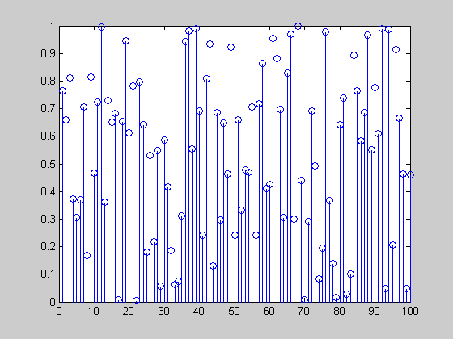
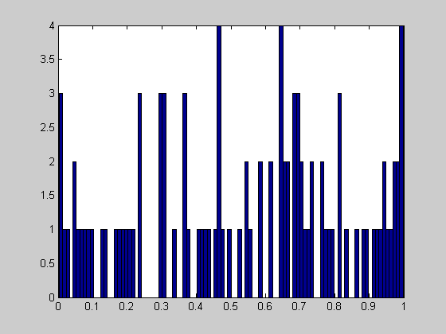
Random Numbers
x=rand(100,1);
stem(x);
hist(x,100)

Slide 58
Thank You…

Slide 59
END
Notes:
59

